Slide 1
Topic 2 – Intro to Data Science
Data Science for Business
Prof: Chris Volinsky
NYU Stern: Spring 2025

Slide 2


What is Data Science?
The science of extracting knowledge and insights from data
But isn’t that the same as statistics?
Statistician: the only valid way to test a theory is to come up with a carefully constructed hypothesis and then collect data in a randomized controlled manner so we can correct for all possible confounding variables and assure ourselves of no bias!
Data Scientist: Whatevs! We’ve got lots of data and cool algorithms – best prediction wins!!!!
Notes:
“Data science is just statistics with better marketing” - unknown
Pros and cons to these two takes:
Sometimes rigor is really important – medical testing, etc.
Depends on the situation.
Distribution focused
Data focused
Focused on models for understanding variable relationships
Focused on algorithms for prediction
Relatively small, clean data sets
Real-world, large, messy data
Used for scientific understanding
Used in business production systems
Starts with hypotheses
Can be exploratory
Obsessed with significance
¯\_(ツ)_/¯

Slide 3
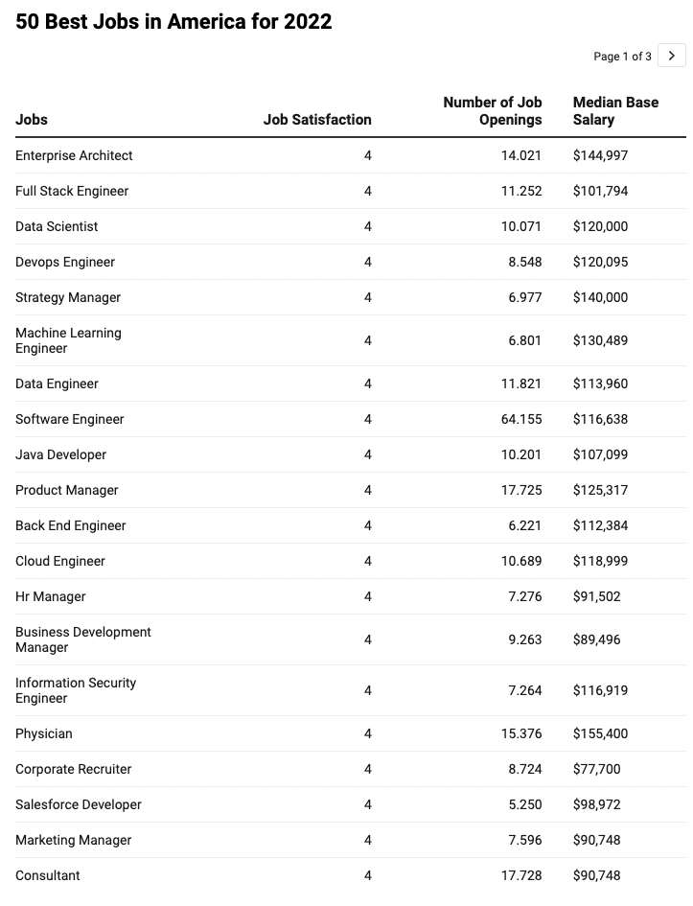
Why Data Science?
Best jobs in America:
Data Literacy will help you in almost any job
Opportunities all along the technical / management scale
Data Science has propelled some of the most successful companies
Source: Glassdoor
Notes:
Any questions about different types of jobs?
Programmer, data engineer
Dashboard designer
Product Manager
Informed decision making
Understand customers
Optimizing operations
Personalize customer experience
Problem solving with data
Tell Signet example here

Slide 4
Our First Use Case: Nadia / MegaTelCo Churn
Nadia is a Product Manager at MegaTelCo, one of the largest telecommunication firms. MegaTelco is having a major problem with net customer churn in their wireless business, and senior leadership has called in Nadia to lead the solution team. You are the lead data scientist reporting into Nadia.
20% of cell-phone customers leave when their contracts expire
Marketing has designed a special retention offer that might be able to convince customers to stay.
What is the business goal?
What is the specific goal of the data science task/model?
What questions might you have for Nadia?
What will be the output of the the data science exercise? What action will you take?
What data could you collect? On what population?
What are 5 specific features you could collect..
How will you measure success?
Notes:
What is churn? Why is it important?
One basis point = bp = .0001 x 80M = 8000 customers you save with one bp improvement of churn x $100 per month = 800k x 12 = 9.6M
Big Question / Small question
Offer: what is it, how much does it cost, can you give it to everybody, is there a downside to giving it to someone who didn’t need it?
One year, get one month free, 20% of next three months? What is their expectation ?
Output/Goal of model: predict who will take the offer? Why people leave? Who is likely to leave? What training set do you need to collect?
Goal: send marketing a list of who to make the offer to.
How does this action
What is success? 30% take the offer.
Will our action solve the big problem? Don’t know!!
What comes from the algorithm?
We also need decision logic.
What is the outcome? Who to send the plan to, or who will take the plan, or who will leave?
Or who will be impacted by the plan? These are all different things!
Final question…why not just make the offer to everybody?
MAJOR POINTS / WRAPUP:
Business goal and DS goal are different but need to be aligned
Different parts of the business might have different goals, output/action/evaluation success needs to be aligned to the business problem.
Anything ethical

Slide 5
Data Science - Process

Slide 6
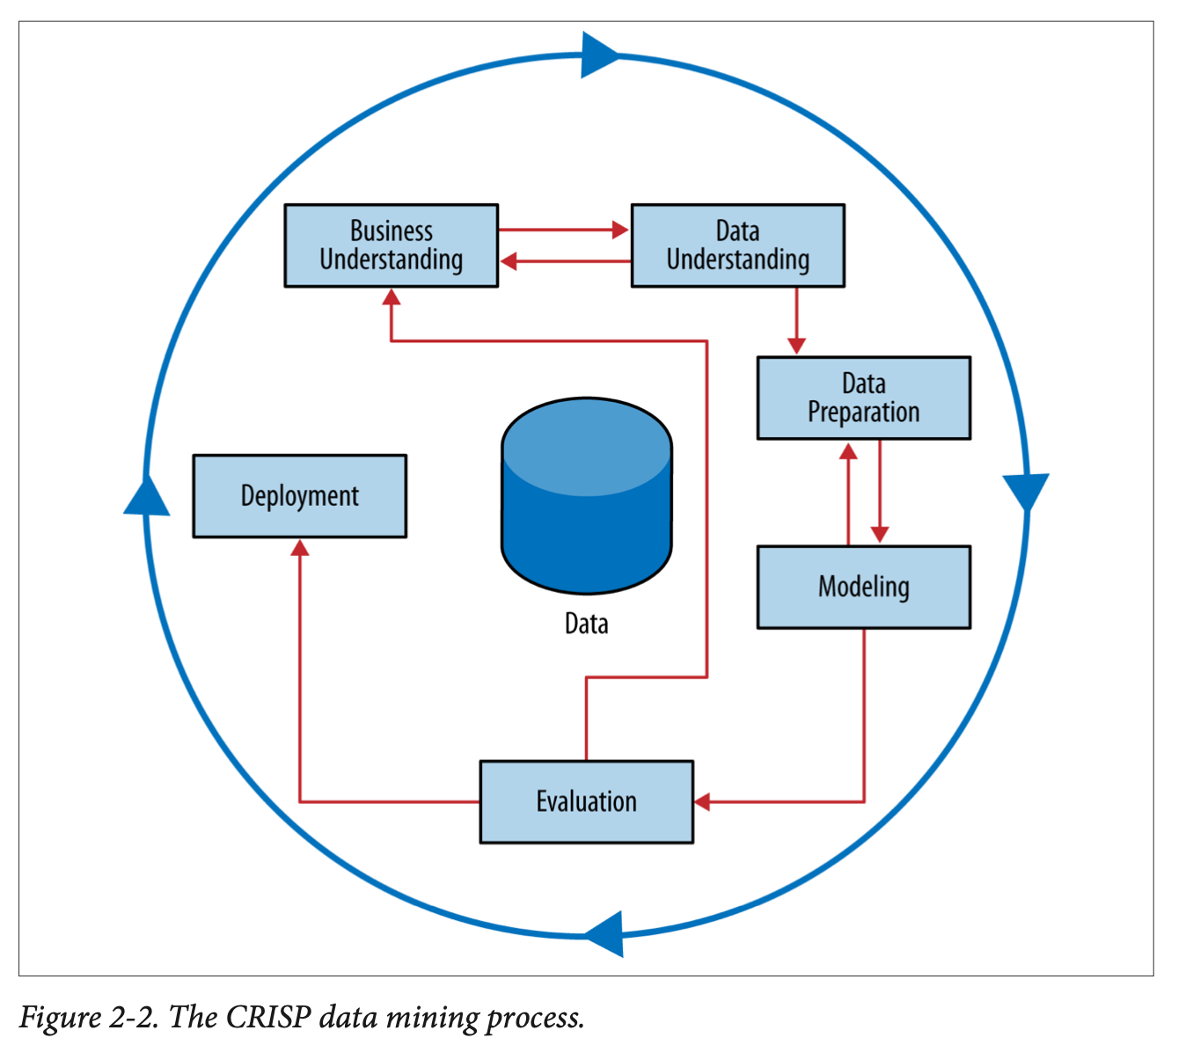
Data Science Process
CRISP-DM =
Cross-Industry Standard Process for Data Mining
Notes:
Work through this on board…
Why a process? Discuss analytics as a craft…this should not be viewed as a formula…more like an “artistic process” – tools, knowledge, experience, common sense.
When to be creative and when to trust the science.

Slide 7
CRISP: Business Understanding

Slide 8


Business Understanding
Data Science should be driven by a key business question
Avoid the “big data pipe dream”
Let’s tell our data scientists to use AI to raise revenue and cut costs!!
Try and break big questions into smaller questions that are answerable by data:
Smaller (specific, answerable) questions:
What are the properties of high performing stores?
Which population segments are buying less?
What strategies reduce customer service hold times?
Big questions:
How do we increase revenue?
How do we diversify customers?
Why is customer satisfaction down?
8
Notes:
8
Problem does not start with data, problem starts with a business need.
Sometimes you do start with a data set and do exploratory work…but that is only typically to do hypothesis generation, and then the questions get more defined
Clustering as an example – customer seg - why do we do it?

Slide 9
Business Understanding
Put the problem into context…ask questions…be creative!
Be prepared to ask…
Who are the stakeholders?
Executive
What is the goal of the solution?
What data is available?
What constraints exist?
How do we evaluate?
What does success look like?
How will people act on the results?
Sales
Marketing
Technology
Operations
Notes:
Always be prepared to ask lots of questions from your data.
e.g. marketing team might want to know who is going to take the offer, but maybe you learn people dont stay after the next year?
Think about churn…there are different stakeholders with different goals! Who is your client, what is best for the company.
WHAT IS THE ACTION?
maybe if you analyze the WHY are people leaving this will generate different tasks for different roles
There are short term, local goals, and there are longer term needs of the businsess.
You can increase sales by offering 50% discount! Yay! What is wrong with that?
You can decrease churn by offering 3 months free.
people who call customer care every day...why?
Executive team – company strength and perception in marketplace
Sales – increase sales!
Marketing – effectiveness of campaign
Technology – people not leaving due to tech issues
Ops – are we losing customers because we cant onboard them quickly enough?.
DS team can be the connectors, and really drive value for the business.

Slide 10
CRISP: Data Understanding

Slide 11

Data
We will spend a lot of time talking about data…
Know where your data comes from
Good to have a contact to be able to explain how the data was created
Know how to get the data
What systems, tools, etc
Understand the data
Spend time with EDA (exploratory data analysis)
Know the limits of your data
Need to spend time cleaning the data, caring for it, understanding it
Example:
Notes:
HBO Max example – looking at what are the qualities of customers who drop - churn
15k minutes of watching in a week…does this make sense?
There are less than that, but maybe multiple devices…so we figured ok,
But device times out after a certain time…
What does the distribution look like?
Even flat with long tail vs
Distribution with a spike at 15k
Vs one big case at 15k

Slide 12
CRISP: Data Preparation for Modeling
Data Prep involves:
Exploratory Data Analysis
Missing data analysis
Outlier detection and assessment
Feature engineering
Data Munging (ugh.)
Notes:
where most of your time is spent

Slide 13
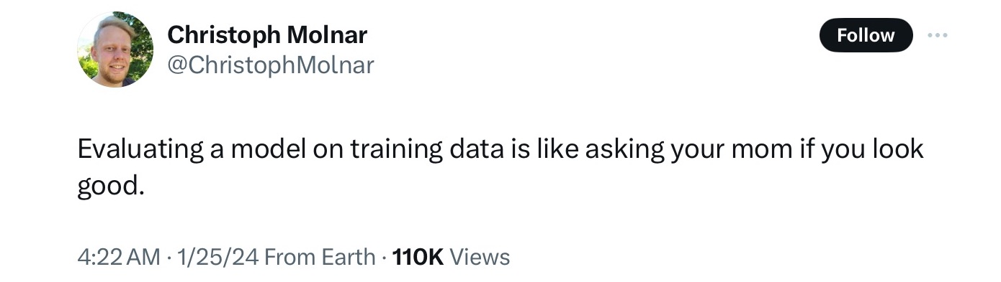
Training and Test sets
This is a core concept in data science / machine learning that separates it from statistics
Why do we need to split data into a training and test sets?
Notes:
Do not want to “memorize” patterns from the training data…
People who live at 50 Olmstead road in Morristown nj like the yankees. That is not actionalble! It is overfitting, it is memorizing.
How does that manifest itself
you can always make the training data look good if you want it to.

Slide 14

Training and Test sets
Randomly partition labeled data into training and test set
Training set – random section of input data – usually between 70-90%
Build model, estimate parameters (e.g., coefficients for a linear regression)
Test set (“hold-out set”) – remaining data (10-30%)
Used to assess model’s performance – on “unseen” data.
Estimates “generalization error” - Model’s error on the test data.
Original data
Training Data
(80%)
Test data
(20%)
Fit model
Evaluate the model
Notes:
(dta

Slide 15
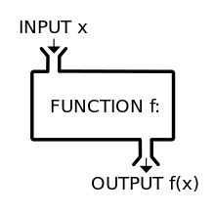
CRISP: Modelling
Modelling
Here we apply machine learning or AI algorithms to make predictions
What data science / ML (algorithms) do you know?
Notes:
What most people think of when they think of DS…
Really just a function to take inputs and create outputs. A lot more goes in but that is basic.
Its a function to create a function!

Slide 16
CRISP: Evaluation

Slide 17
CRISP - Evaluation
We must define a numerical metric to determine the best model or the appropriate parameters to use
Examples: RMSE, MAE, ROC Curves
Evaluation metric should be tied to the business problem
Recommender Systems : popular items will score very well!
The ”best” performance might not actually have practical significance
What does your RMSE mean??
Always ask: Is the success metric of the evaluation aligned with the business need?
Need to compare to baseline, or dumb models
Notes:
???What do you know?
RMSE/MAE
Accuracy
ROC curves
(note these are all calculated on already collected data and might be different once deployed)
Does your evaluation metric tie to a business success?
Back to Churn – does the goal of the metric mean we have a valuable model.
Recommender systems…great! I can give people movies they like!
Movie gross…can I predict movie grosses
- short term benefit for long term loss
- benefit to one team but not to the company as a whole
- or a blind spot leads to bias in deployment

Slide 18
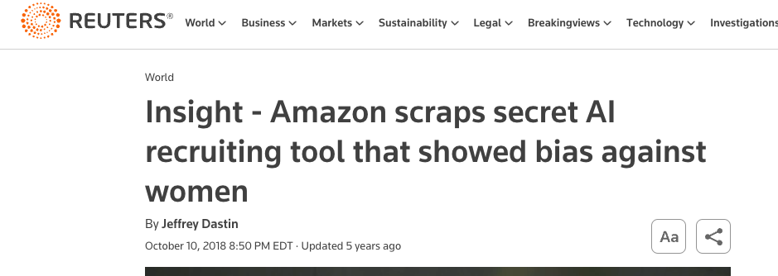
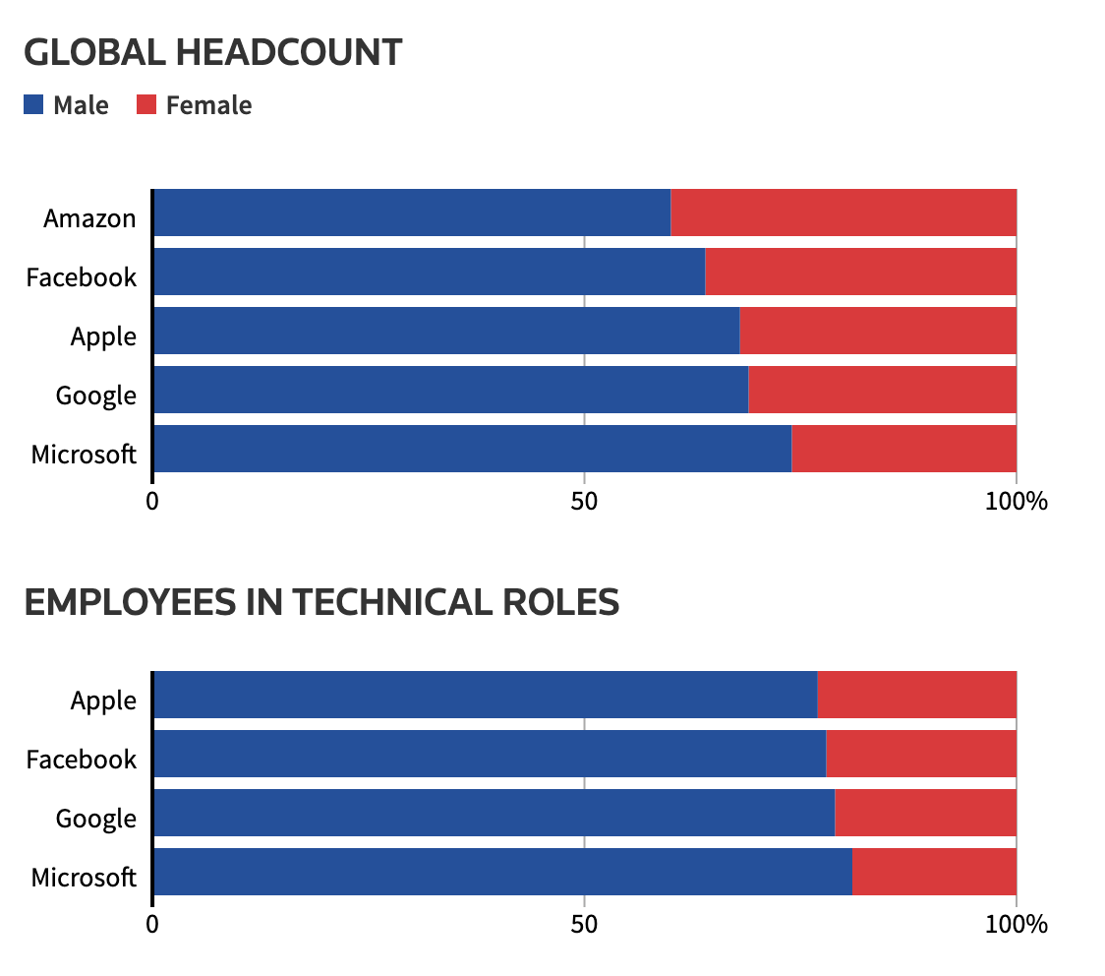
Bias in Machine Learning
Amazon HR hiring tool
“…Amazon's computer models were trained to vet applicants by observing patterns in resumes submitted to the company over a 10-year period. Most came from men, a reflection of male dominance across the tech industry. ”
Other examples of bias??
https://www.reuters.com/article/idUSKCN1MK0AG/
Notes:
Facial Recognition, voice recognition
Algorithms for sentencing (COMPASS)
Credit decisions…
Google Gemini

Slide 19
CRISP: Deployment
How are you going to act on the outcome of your model?
What decisions will be made?
How will the success be measured?

Slide 20

Deployment
One critical aspect of every data science exercise in business:
What action will be taken?
Models don’t have business value until they get into production
Deployment decisions can effect the impact of the model
Deployment always has surprises!
Deploy slowly with pilot studies, and A/B testing
Careful monitoring and feedback loops
[machine learning engineers deploying a model]
DS teams and deployment teams (engineers, DevOps, QA, ..) should be integrated from the start
Notes:
Deployment issues : lets say I have a model for Walmart to give someone an ad…where is this model run? Is it run at the time of the customer logs on? Or offline? How complex is the moel
Have them go through what happens when the DS team comes up with a good model…we can improve engagement. Marketing team comes up with a good model, but there are a lot of steps to get approved.
Requires teams to work well together, subject matter expertise on both sides! That is why having a range of knowledge from CS to stat is important!
Typically it is a scoring algorithm that gets deployed
In some cases the ML is deployed in the network – for example new ad campaign can learn who is clicking early, and then automatically find more of those types.

Slide 21
Iterate …
Business Problem
Data
Action
Analysis
Notes:
So many focus on algorithm…but much much more
Must come back to Bus Und!!

Slide 22
Data Science Framework – In Action
Back to Nadia…
Notes:
Think through the steps…big problem, small problem…does solving the small problem impact the big problem?
Data – what are the most important things that might impact churn?
WHAT data would you aslk for – on whom (e.g. only those that left at end of contract?) First Contract?
How do you know who left? What does it mean to cancel?
How far back do you go?
Model – Control data?
what are you training your data on…
Evaluation: what is success? Evaluation before deployment?
What about after deployment? Early stopping?
What is baseline?
How do you turn probabilities into deployed action?
How do you evaluate probabilities? You never observe them? How do you know if it is correct?
Is it just a threshold? what do you do if the customer is high risk but is already under contract? what if a customer is low risk but very valuable?

Slide 23
Data Science - Terminology

Slide 24
Types of Data Science Tasks
Supervised
Unsupervised
There is a specific, quantifiable target that we are interested in or trying to predict
There is no such target, we are just trying to understand the data
Predictive!
Descriptive!
Predict whether a customer will buy our product based on her browsing habits of our website!
Segment customer base into clusters that help define broad customer types
Most data science algorithms
(e.g. decision trees, Regression)
Data Visualization
Segmentation
Clustering
Notes:
Another way of saying the same thing
Note – can add re-inforcement mearning here. You update the model as you get input/

Slide 25
Supervised Learning
Supervised
Classification
Regression
Time series
Other…
Prediction variable is categorical (perhaps binary)
Prediction variable is numeric - continuous
Data are time-based: forecasting into future
Predicting text or media…
Will the loan applicant default on their loan?
How much money will this customer spend on my product next year?
What will the DJIA close at next month?
What should my customer care chatbot say next?
Not cut and dried…tasks can fall between categories
Notes:
Multi factor could be like a customer segmentation model:
Hi value -
Lo value
Frequent purchaser
Don’t take this too seriously
sometimes you need to do both classification and regression...
or time series and regression
New product…will they buy the product, how much will they spend IF they buy the product.

Slide 26
Example
Loan Applicants – goal is to build a model to assess what factors result in loan default
Data:
Name | Industry | Age | Date | Balance | Default
Mike | Finance | 30 | 02/13/04 | 123,000 | Yes
Mary | Medical | 40 | 29/06/13 | 51,100 | Yes
Bill | Construction | 55 | 14/08/09 | 68,000 | No
Jim | Medical | 46 | 01/01/07 | 74,000 | No
Mark | Finance | 47 | 23/12/11 | 23,000 | Yes
Anne | Finance | 49 | 19/0512 | 100,000 | No
Supervised or unsupervised?
Classification or regression?
What action might we take??
Notes:
Action…don’t accept the loan!
Q: what is the action that they might take?
What is the outcome of the model?
What is the action of the model?
Put the model in the hands of the loan officer, who can make a judgement…

Slide 27
Supervised example
Loan Applicants – goal is to build a model to assess what factors result in loan default
Data:
Variables
Attributes
Features
Independent Variables
Predictors
Target
Dependent Variable
Identifier
Name | Industry | Age | Date | Balance | Default
Mike | Finance | 30 | 02/13/04 | 123,000 | Yes
Mary | Medical | 40 | 29/06/13 | 51,100 | Yes
Bill | Construction | 55 | 14/08/09 | 68,000 | No
Jim | Medical | 46 | 01/01/07 | 74,000 | No
Mark | Finance | 47 | 23/12/11 | 23,000 | Yes
Anne | Finance | 49 | 19/0512 | 100,000 | No
Observations
Instances
Data Points
Examples
X
Y

Slide 28
Model
Model: takes features as inputs, gives a prediction as an output
Name | Industry | Age | Date | Balance | Default
Mike | Finance | 30 | 02/13/04 | 123,000 | Yes
Mary | Medical | 40 | 29/06/13 | 51,100 | Yes
Bill | Construction | 55 | 14/08/09 | 68,000 | No
Jim | Medical | 46 | 01/01/07 | 74,000 | No
Mark | Finance | 47 | 23/12/11 | 23,000 | Yes
Anne | Finance | 49 | 19/0512 | 100,000 | No
Algorithm:
Inputs features
Outputs prediction
Classification Model:
If Age > 45, predict No Default
Notes:
Ask “what is the performance of this model?

Slide 29
Supervised Models
A model can be any function that takes inputs and makes a predictive output
Name | Age | Balance | Default
Mike | 30 | 123,000 | Yes
Mary | 40 | 51,100 | Yes
Bill | 55 | 68,000 | No
Jim | 46 | 74,000 | No
Mark | 47 | 23,000 | Yes
Anne | 49 | 100,000 | No
If Names starts with M
Then Default = ‘yes’
Else Default = ‘no’
Age is inversely proportional
to default
The model allows you to make predictions for cases you have not seen before (assuming the same data attributes)
If Balance >= 50K and Age > 45
Then Default = ‘no’
Else Default = ‘yes’
Notes:
Can they come up with them?

Slide 30
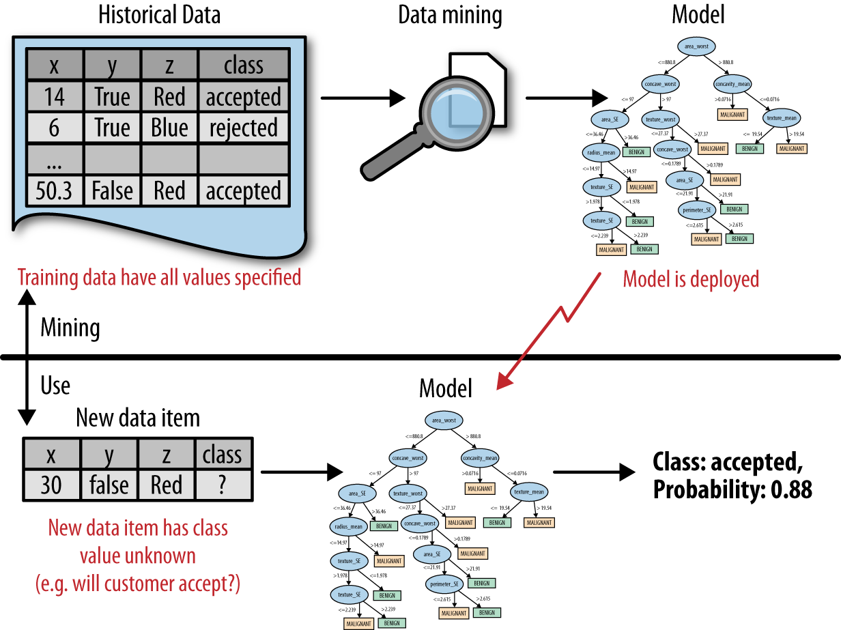
Back to the process …
DSB Fig2-1
Predictive analytics flow
data science / Learning / Training the model
Prediction
Decision/Action
“Send offer”
Using the model
Notes:
Put on board as data science vs use (deployment)
Data – science – selected mdlel
========================
New data – model – prediction – action (--outcome--feedback)
ML is a pogram that writes programs

